Slide 1
COMPUTING AND TECHNOLOGY DEPARTMENT BUGEMA UNIVERSITY
Network Design
BY
OMARA GODFREY

Slide 2
Introduction to network design
We have seen dramatic changes in the business climate in the 1990s, especially
with the growth of e-business on the Internet. More business is conducted
electronically and deals are closed in lightning speed. These changes have
affected how a company operates in this electronic age and computer systems
Internet Engineering Course; Sharif University of Technology

Slide 3
Cont’s
have taken a very important role in a company’s profile. The Internet has
introduced a new turf for companies to compete and more companies are going
global at the same time to grow revenues. Connectivity has never been as
important as it is today.
The growth of the Internet has reached a stage where a company has to get
connected to it in order to stay relevant and compete. The traditional text-based
Internet Engineering Course; Sharif University of Technology

Slide 4
Cont’s
transaction systems have been replaced by Web-based applications with
multimedia contents. The technologies that are related to the Internet have
become mandatory subjects not only for MIS personnel, but even the CEO. And
TCP/IP has become a buzzword overnight.
• What is TCP/IP?
• How does one build a TCP/IP network?
• What are the technologies involved?
Internet Engineering Course; Sharif University of Technology

Slide 5
Cont’s
• How does one get connected to the Internet, if the need arises?
• Are there any guidelines?
While this book does not and cannot teach you how to run your business, it briefly
describes the various TCP/IP components and provides a comprehensive
approach in building a TCP/IP network.
Internet Engineering Course; Sharif University of Technology

Slide 6
The Internet Model
It has been estimated that there are currently 80,000,000 hosts connected to the Internet.
The rapid rise in popularity of the Internet is mainly due to the World
Wide Web (WWW) and e-mail systems that enable free exchanges of information.
A cursory glance at the history of the Internet and its growth enables you to
understand the reason for its popularity and perhaps, predict some trend towards
how future networks should be built.
Internet Engineering Course; Sharif University of Technology

Slide 7
the Internet and IP Technologies
In the 1960s and 1970s, many different networks were running their own
protocols and implementations. Sharing of information among these networks
soon became a problem and there was a need for a common protocol to be
developed. The Defense Advanced Research Projects Agency (DARPA) funded
the exploration of this common protocol and the ARPANET protocol suite, which
introduced the fundamental concept of layering.
Internet Engineering Course; Sharif University of Technology

Slide 8
Cont’s
The TCP/IP protocol suite then
evolved from the ARPANET protocol suite and took its shape in 1978. With the
use of TCP/IP, a network was created that was mainly used by government
agencies and research institutes for the purpose of information sharing and
research collaboration.
In the early 1980s TCP/IP became the backbone protocol in multivendor networks
such as ARPANET, NFSNET and regional networks. The protocol suite was
Internet Engineering Course; Sharif University of Technology

Slide 9
integrated into the University of California at Berkeley¢ s UNIX operating system
and became available to the public for a nominal fee. From this point on TCP/IP
became widely used due to its inexpensive availability in UNIX and its spread to other operating systems.
Internet Engineering Course; Sharif University of Technology

Slide 10
Today, TCP/IP provides the ability for corporations to merge differing physical
networks while giving users a common suite of functions. It allows interoperability between equipment supplied by multiple vendors on multiple
platforms, and it provides access to the Internet.
The Internet of today consists of large international, national and regional backbone networks, which allow local and campus networks and individuals
access to global resources. Use of the Internet has grown exponentially over the
Internet Engineering Course; Sharif University of Technology

Slide 11
last three years, especially with the consumer market adopting it.
Internet Engineering Course; Sharif University of Technology

Slide 12
So why has the use of TCP/IP grown at such a rate?
The reasons include the availability of common application functions across
differing platforms and the ability to access the Internet, but the primary reason is that of interoperability. The open standards of TCP/IP allow corporations to interconnect or merge different platforms.
Internet Engineering Course; Sharif University of Technology

Slide 13
Cont’s
An example is the simple case of allowing file transfer capability between an IBM MVS/ESA host and, perhaps, an Apple Macintosh workstation.
TCP/IP also provides transport for other protocols such as IPX, NetBIOS or SNA. For example, these protocols could make use of a TCP/IP network to connect to
Internet Engineering Course; Sharif University of Technology

Slide 14
Cont’s
other networks of similar protocol.
One further reason for the growth of TCP/IP is the popularity of the socket programming interface, which is the programming interface between the TCP/IP transport protocol layer and TCP/IP applications.
Internet Engineering Course; Sharif University of Technology

Slide 15
Cont’s
A large number of applications today have been written for the TCP/IP socket interface. The Request for Comments (RFC) process, overseen by the Internet Architecture Board (IAB) and the Internet Engineering Task Force (IETF), provides for the continual upgradin
and extension of the protocol suite.
Internet Engineering Course; Sharif University of Technology

Slide 16
Open Systems Interconnection (OSI) Model
Read about this and write about the historical of OSI model and list down layers and explain each layer in details after compeer it with TCP/IP model (assignment-1)
Internet Engineering Course; Sharif University of Technology

Slide 17
Designing an IP Network
Due to the simplicity and flexibility of IP, a network can be "hacked" together in an
unordered fashion. It is common for a network to be connected in this manner,
and this may work well for small networks. The problem arises when changes are required and documentation is not found. Worst of all, if the network design/implementation teams leave the organization, the replacements are left with the daunting task of finding out what the network does, how it fits together, and what goes where!
Internet Engineering Course; Sharif University of Technology

Slide 18
Cont’s
An IP network that has not been designed in a systematic fashion will invariably
run into problems from the beginning of the implementation stage. When you are
upgrading an existing network, there are usually legacy networks that need to be connected. Introducing of new technology without studying the limitations of the current network may lead to unforeseen problems. You may end up trying to solve a problem that was created unnecessarily. For example, the introduction of an Ethernet network in a token-ring environment has to be carefully studied.
Internet Engineering Course; Sharif University of Technology

Slide 19
The design of the network must take place before any implementation takes place.
The design of the IP network must also be constantly reviewed as requirements change over time
Internet Engineering Course; Sharif University of Technology

Slide 20
Cont’s
Initial Design
Deployment
Commissioning
Design Change
Internet Engineering Course; Sharif University of Technology

Slide 21
Cont’s
A good IP network design also includes detailed documentation of the network for
future reference. A well designed IP network should be easy to implement, with
few surprises. It is always good to remember the KISS principle: Keep It Simple Stupid!
Internet Engineering Course; Sharif University of Technology

Slide 22
The Design Methodology
The design methodology recommended for use in the design of an IP network is a
top-down design approach.
This technique of design loosely follows the TCP/IP stack.
at the top of the stack lies the application layer. This is the first layer considered when designing the IP network. The next two layers are the transport and network layers with the final layer being the data link layer.
Internet Engineering Course; Sharif University of Technology

Slide 23
Cont’s
The design of an application is dictated by business requirements. The rules of
the business, the process flow, the security requirements and the expected
results all get translated into the application’s specification. These requirements
not only affect the design of the application but their influence permeates all the
way down to the lower layers.
Internet Engineering Course; Sharif University of Technology

Slide 24
Once the application layer requirements have been identified, the requirements
for the lower layers follow. For example, if the application layer has a program that demands a guaranteed two-second response time for any network transaction,
the IP network design will need to take this into consideration and maybe place performance optimization as high priority.
Internet Engineering Course; Sharif University of Technology

Slide 25
The link layer will need to be designed
in such a manner that this requirement is met. Using a flat network model for the link layer with a few hundred Windows-based PCs may not be an ideal design in this case.
Internet Engineering Course; Sharif University of Technology

Slide 26
Cont’s
Once the design of the IP network has been completed with regard to the application layer, the implementation of the network is carried out.
The design for the network infrastructure plays an important part, as it ultimately affects the overall design. A good example of this is the modularity and scalability of the overall IP network. The following are some basic considerations in designing an IP network.
Internet Engineering Course; Sharif University of Technology

Slide 27
Overall Design Considerations
Although much could be said about design considerations that is beyond the
scope of this book, there are a few major points that you need to know:
Internet Engineering Course; Sharif University of Technology

Slide 28
Scalability
A well designed network should be scalable, so as to grow with increasing
requirement. Introduction of new hosts, servers, or networks to the network
should not require a complete redesign of the network topology. The
topology chosen should be able to accommodate expansion due to
business requirements.
Internet Engineering Course; Sharif University of Technology

Slide 29
Open Standards
The entire design and the components that build the network should be
based on open standards. Open standards imply flexibility, as there may be
a need to interconnect different devices from different vendors. Proprietary
features may be suitable to meet a short term requirement but in the long
run, they will limit choices as it will be difficult to find a common technology.
Internet Engineering Course; Sharif University of Technology

Slide 30
Availability/Reliability
Business requirements assuredly demand a level of availability and
reliability of the network. A stock trading system based on a network that
guarantees transaction response times of three seconds is meaningless if
the network is down three out of seven days a week!
Internet Engineering Course; Sharif University of Technology

Slide 31
Cont’s
The mean time between failures (MTBF) of the components must be
considered when designing the network, as must the mean time to repair
(MTTR). Designing logical redundancy in the network is as important as
physical redundancy.
It is too late and costly to consider redundancy and reliability of a network
when you are already halfway through the implementation stage.
Internet Engineering Course; Sharif University of Technology

Slide 32
Modularity
An important concept to adopt is the modular design approach in building a network. Modularity divides a complex system into smaller, manageable ones and makes implementation much easier to handle. Modularity also ensures that a failure at a certain part of the network can be isolated so
that it will not bring down the entire network.
Internet Engineering Course; Sharif University of Technology

Slide 33
Cont’s
The expendability of a network is improved by implementing a modular
design. For example, adding a new network segment or a new application
to the network will not require re-addressing all the hosts on the network if the network has been implemented in a modular design.
Internet Engineering Course; Sharif University of Technology

Slide 34
Security
The security of an organization’s network is an important aspect in a
design, especially when the network is going to interface with the Internet.
Considering security risks and taking care of them in the design stage of the IP network is essential for complete certitude in the network.
Considering security at a later stage leaves the network open to attack until
Internet Engineering Course; Sharif University of Technology

Slide 35
Cont’s
all security holes are closed, a reactive rather than proactive approach that sometimes is very costly. Although new security holes may be found as the hackers get smarter, the basic known security problems can easily be incorporated into the design stage.
Internet Engineering Course; Sharif University of Technology

Slide 36
Network Management
IP network management should not be an afterthought of building a
network. Network management is important because it provides a way to
monitor the health of the network, to ascertain operating conditions, to
isolate faults and configure devices to effect changes.
.
Internet Engineering Course; Sharif University of Technology

Slide 37
Cont’s
Implementing a management framework should be integrated into the
design of the network from the beginning. Designing and implementing an
IP network and then trying to "fit" a management framework to the network may cause unnecessary issues. A little proactivity in the design stage can lead to a much easier implementation of management resources
Internet Engineering Course; Sharif University of Technology

Slide 38
Performance
There are two types of performance measures that should be considered
for the network. One is the throughput requirement and the other is the
response time. Throughput is how much data can be sent in the shortest
time possible, while response time is how long a user must wait before a
result is returned from the system.
Internet Engineering Course; Sharif University of Technology

Slide 39
Cont’s
Both of these factors need to be considered when designing the network. It is not acceptable to design a network only to fail to meet the organization’s
requirements in the response times for the network. The scalability of the
network with respect to the performance requirements must also be
considered, as mentioned above.
Internet Engineering Course; Sharif University of Technology

Slide 40
Economics
An IP network design that meets all of the requirements of the organization
but is 200% of the budget, may need to be reviewed.
Balancing cost and meeting requirements are perhaps the most difficult
aspects of a good network design. The essence is in the word compromise.
One may need to trade off some fancy features to meet the cost, while still
meeting the basic requirements.
Internet Engineering Course; Sharif University of Technology

Slide 41
Network Design Steps
Below is a generic rule-of-thumb approach to IP network design. It presents a
structured approach to analyzing and developing a network design to suit the
needs of an organization.
Internet Engineering Course; Sharif University of Technology

Slide 42
Cont’s
Network Objectives
Collect Design Information
Create Design Proposal
Propose Configuration
Have all designs
been considered?
Make Selection
Move to Implementation
Internet Engineering Course; Sharif University of Technology

Slide 43
Network Objectives
What are the objectives of this IP network? What are the business requirements
that need to be satisfied? This step of the design process needs research and can be time consuming.
Internet Engineering Course; Sharif University of Technology

Slide 44
Collecting Design Information
The information that is required for building the network depends on each individual implementation. However, the main types of information required can be deduced
It is important to collect this information and spend time analyzing it to develop a
thorough understanding of the environment and limitations imposed upon the
design of the new IP network.
Internet Engineering Course; Sharif University of Technology

Slide 45
Create a Proposal or Specification
Upon analysis of the collected information and the objectives of the network, a
design proposal can be devised and later optimized. The design considerations
can be met with one goal overriding others. So the network can be:
Internet Engineering Course; Sharif University of Technology

Slide 46
Cont’s
• Optimized for performance
• Optimized for resilience
• Optimized for security
Once the design priorities have been identified the design can be created and
documented.
Internet Engineering Course; Sharif University of Technology

Slide 47
Review
The final stage in the design process is to review the design before it is
implemented. The design can be modified at this stage easily, before any
investment is made into infrastructure or development work. With this completed,
the implementation stage can be initiated.
Internet Engineering Course; Sharif University of Technology

Slide 48
Application Considerations
As presented in chapter one, the TCP/IP model’s highest layer is the application
layer. As the elements that populate this layer are defined by the business
requirements of the overall system, these components must be considered the
most important in the initial design considerations with a top-down design
methodology.
Internet Engineering Course; Sharif University of Technology

Slide 49
Cont’s
The type of applications that the network needs to support and the types of
network resources these applications require, must be taken into consideration
when designing the IP network. There are a number of these issues that must be
considered for the network design, some that are common to all applications,
while others pertain to a subset of applications. These issues will be defined and
elaborated.
Internet Engineering Course; Sharif University of Technology

Slide 50
Cont’s
Remember, building a complex ATM network to send plain text in a small workgroup of 10 users is a waste of time and resources, unless you get them for free!
Internet Engineering Course; Sharif University of Technology

Slide 51
Bandwidth Requirements
Different applications require varying amounts of network bandwidth.
A simple SMTP e-mail application does not have the same bandwidth requirement as a
Voice over IP application. Voice and data compression have not reached that level yet.
Internet Engineering Course; Sharif University of Technology

Slide 52
Cont’s
It is obvious that the applications your network will need to support determine the
type of network you will finally design. It is not a good idea to design a network
without considering what applications you currently require, and what applications your business needs will require your network to support in the
future.
Internet Engineering Course; Sharif University of Technology

Slide 53
Performance Requirements
The performance requirements of the users of the applications must be considered. A user of the network may be willing to wait for a slow response from an HTTP or FTP application, but they will not accept delays in a Voice over IP
application - it’s hard to understand what someone is saying when it’s all broken up.
Internet Engineering Course; Sharif University of Technology

Slide 54
Cont’s
The delay in the delivery of network traffic also needs to be considered. Long
delays will not be acceptable to applications that stream data, such as video over IP applications.
The accuracy with which the network is able to provide data to the application is also relevant to the network design. Differing infrastructure designs provide differing levels of accuracy from the network.
Internet Engineering Course; Sharif University of Technology

Slide 55
Protocols Required
The TCP/IP application layer supports an ever increasing number of protocols.
The basic choice in protocol for applications is whether or not the application will
use TCP or UDP. TCP delivers a reliable connection-oriented service. UDP delivers faster network response by eliminating the overhead of the TCP header; however, it loses TCP’s reliability, flow control and error recovery features.
Internet Engineering Course; Sharif University of Technology

Slide 56
cont’s
It is clear that it depends on the application’s service focus as to which protocol it
will use. An FTP application, for example, will not use UDP. FTP uses TCP to
provide reliable end-to-end connections. The extra speed provided by using UDP
does not outweigh the reliability offered by TCP.
Internet Engineering Course; Sharif University of Technology

Slide 57
Cont’s
The Trivial File Transfer Protocol (TFTP), however, although similar to FTP, is based on a UDP transport layer. As TFTP transactions are generally small in size
and very simple, the reliability of the TCP protocol is outweighed by the added speed provided by UDP. Then why use FTP? Although TFTP is more efficient
than FTP over a local network, it is not good for transfers across the Internet as its speed is rendered ineffective due to its lack of reliability. Unlike FTP
applications TFTP applications are also insecure.
Internet Engineering Course; Sharif University of Technology

Slide 58
Quality of Service/Type of Service (QoS/ToS)
Quality of Service (QoS) and Type of Service (ToS) arise simply for one reason:
some users’ data is more "important" then others. And there is a need to provide
these users with "premium" service, just like a VIP queue at the airport.
Internet Engineering Course; Sharif University of Technology

Slide 59
Cont’s
The requirement for QoS and ToS that gets incorporated into an application also
has implications for the network design. The connecting devices, the routers and
switches, have to be able to ensure "premium" delivery of information so as to
support the requirement of the application.
Internet Engineering Course; Sharif University of Technology

Slide 60
Real-Time Applications
Some applications, such as a Voice over IP or an ordering system, need to be real time. The need for real-time applications necessitates a network that can guarantee a level of service.
A real-time application will need to implement its own flow control and error checking if it is to use UDP as a transport protocol. The requirements of real-time
Internet Engineering Course; Sharif University of Technology

Slide 61
Cont’s
applications will also influence the type of network infrastructure implemented.
An ATM network can inherently fulfill the requirements, however, a shared Ethernet
network will not fulfill the requirement.
Internet Engineering Course; Sharif University of Technology

Slide 62
Sensitivity to Packet Loss and Delay
An application’s sensitivity to packet loss and delay can have dramatic effects on the user. The network must provide reliable packet delivery for these applications.
For example, a real-time application, with little buffering, does not tolerate packet delivery delays, let alone packet loss! Voice over IP is one example of such an application, as opposed to an application such as Web browsing.
Internet Engineering Course; Sharif University of Technology

Slide 63
Multicast
Multicasting has been proven to be a good way of saving network bandwidth.
That is true, if it has been implemented properly and did not break the network in the first place.
Getting multicasting to work involves getting all the connecting devices, such as routers and switches, the applications, the clients’ operating systems, and the
servers to work hand in hand. Multicasting will not work if any of these subsystems cannot meet the requirement, or if they have severe limitations.
Internet Engineering Course; Sharif University of Technology

Slide 64
Proxy-Enabled
The ability of an application protocol to be proxies has implications on the bandwidth requirements and the security of the network.
An HTTP application will be easily manageable when a firewall is installed for security, as a proxy service can be placed outside the firewall in a demilitarized zone to serve HTTP traffic through the firewall to the application.
Internet Engineering Course; Sharif University of Technology

Slide 65
Cont’s
An application based upon the TELNET protocol will not have such an easy time
as the HTTP application. The TELNET protocol does not support proxying of its
traffic. Thus, a firewall must remain open on this port, the application must use a
SOCKS server or the application cannot communicate through the firewall. You
either have a nonworking application, an added server or a security hole.
Internet Engineering Course; Sharif University of Technology

Slide 66
Directory Needs
Various applications require directory services with the IP network. Directory
services include DNS, NIS, LDAP, X.500 and DCE, among others. The choice of Directory services depends on the application support for these services. An application based upon the ITU X.500 standard will not respond well to a network with only DNS servers.
Internet Engineering Course; Sharif University of Technology

Slide 67
Cont’s
Some applications, such as those based upon the PING and TFTP protocols, do not require directory services to function, although the difficulty in their use would be greatly increased. Other applications require directory services implicitly, such as e-mail applications based on the SMTP protocol.
Internet Engineering Course; Sharif University of Technology

Slide 68
Distributed Applications
Distributed applications will require a certain level of services from the IP network. These services must be catered for by the network, so they must be considered in the network design.
Internet Engineering Course; Sharif University of Technology

Slide 69
Cont’s
Take Distributed Computing Environment (DCE) as an example. It provides a platform for the construction and use of distributed applications that relies on services such as remote procedure call (RPC), the Cell Directory Service (CDS), Global Directory Service (GDS), the Security Service, DCE Threads, Distributed Time Service (DTS), and Distributed File Service (DFS). These services have to made available through the network, so that collectively, they provide the basic secure core for the DCE environment.
Internet Engineering Course; Sharif University of Technology

Slide 70
Scalability
Applications that require scalability must have a network capable to cater for their
future requirements, or be able to be upgraded for future requirements. If an
application is modular in design, the network must also be modular to enable it to
scale linearly with the application’s requirements.
Internet Engineering Course; Sharif University of Technology

Slide 71
Security
The security of applications is catered for by the underlying protocols or by the
application itself. If an application uses UDP for its transport layer, it cannot rely
on SSL for security, hence it must use its own encryption and provide its own
security needs.
Internet Engineering Course; Sharif University of Technology

Slide 72
Cont’s
Some applications that need to be run on the network do not have built-in security
features, or have not implemented standard security concepts such as SSL. An
application based on the TELNET protocol, for example, will invariably be
unsecure. If the network security requirements are such that a TELNET
application sending out unencrypted passwords is unacceptable, then either the
TELNET port must be closed on the firewall or the application must be rewritten.
Is it really worth rewriting your TELNET program?
Internet Engineering Course; Sharif University of Technology

Slide 73
Platform Considerations
An important step toward building an application is to find out the capabilities of
the end user’s workstation - the platform for the application. Some of the basic
questions that have to be answered include:
Internet Engineering Course; Sharif University of Technology

Slide 74
Cont’s
Whether the workstation supports graphics or only text
• Whether the workstation meets the basic performance requirement in terms of
CPU speed, memory size, disk space and so on
• Whether the workstation has the connectivity options required
Internet Engineering Course; Sharif University of Technology

Slide 75
Infrastructure Considerations
The applications need a transport mechanism to share information, to transmit
data or to send requests for some services. The transport mechanism is provided
by the underlying layer called the network infrastructure.
Building a network infrastructure can be a daunting task for the inexperienced.
Imagine building a network for a company with 100,000 employees and 90
different locations around the world.
Internet Engineering Course; Sharif University of Technology

Slide 76
Cont’s
The Internet as we have it today grew out of circumstances. In the beginning, it
was not designed to be what it is today. In fact, there was not any planning or
design work done for it. It is merely a network of different networks put together,
and we have already seen its problems and limitations:
Internet Engineering Course; Sharif University of Technology

Slide 77
Cont’s
• It has almost run out of IP addresses
• It has performance problems
• It cannot readily support new generation applications
• It does not have redundancy
• It has security problems
• It has erratic response time
Internet Engineering Course; Sharif University of Technology

Slide 78
Work has begun on building the so-called New Generation Internet (NGI) and it is
supposed to be able to address most, if not all, of the problems that we are
experiencing with the Internet today. The NGI will be entirely different from what
we have today, as it is the first time that a systematic approach has been used to
design and build an Internet.
Internet Engineering Course; Sharif University of Technology

Slide 79
The Perfect Network
So, you may ask: Is there such a thing as a perfect network?
If a network manager is assigned to build a network for a company, he/she would
have to know how to avoid all the problems we have mentioned above. He or she
would use the best equipment and would have chosen the best networking
technologies available, but may still not have built a perfect network.
Internet Engineering Course; Sharif University of Technology

Slide 80
Cont’s
The truth is, there is no such thing as a perfect network. A network design that is
based on today’s requirements may not address those of the future. Business
environments change, and this has a spiraling effect on the infrastructure.
Expectations of employees change, the users’ requirements change, and new
needs have to be addressed by the applications, and these in turn affect how all
Internet Engineering Course; Sharif University of Technology

Slide 81
Cont’s
the various systems tie up together, which means there is a change in the
network infrastructure involved. At best, what the network could do is to scale and
adapt to changes. Until the day it has reached its technical limitation, these are
the two criteria for a network to stay relevant; after that, a forklift operation may be
required.
Internet Engineering Course; Sharif University of Technology

Slide 82
Cont’s
Networks evolve over time. They have to do so to add value.
The above sections have highlighted that much work has to be done before an
application gets to be deployed to support a business’ needs. From the network
infrastructure to the various system designs, server deployments, security
considerations and types of client workstations, they all have to be well
coordinated. A minor error could mean back to the drawing board for the system
designer, and lots of money for the board of directors.
Internet Engineering Course; Sharif University of Technology

Slide 83
The Network Infrastructure
The network infrastructure is an important component in IP network design. It is
important simply because, at the end of the day, it is those wires that carry the
information. A well thought-out network infrastructure not only provides reliable
and fast delivery of that information, but it is also able to adapt to changes, and
grow as your business expands.
Internet Engineering Course; Sharif University of Technology

Slide 84
Cont’s
Building a network infrastructure is a complex task, requiring work such as
information gathering, planning, designing, and modeling. Though it deals mainly
with bits and bytes, it is more of an art than a science, because there are no fast
rules to building one.
Internet Engineering Course; Sharif University of Technology

Slide 85
Cont’s
When you build a network infrastructure, you look more at the lower three layers
of the OSI model, although many other factors need to be considered. There are
many technologies available that you can use to build a network, and the
challenge that a network manager faces, is to choose the correct one and the tool
that comes with it. It is important to know the implications of selecting a particular
technology, because the network manager ultimately decides what equipment is
required.
Internet Engineering Course; Sharif University of Technology

Slide 86
Cont’s
When selecting a piece of networking equipment, it is important to know
at which layer of the OSI model the device functions. The functionality of the
equipment is important because it has to conform to certain standards, it has to
live up to the expectation of the application, and it has to perform tasks that are
required by the blue print - the network architecture.
Internet Engineering Course; Sharif University of Technology

Slide 87
Cont’s
The implementation of IP over different protocols depends on the mechanism
used for mapping the IP addresses to the hardware addresses, or MAC address,
at the data link layer of the OSI model. Some important aspects to consider when
using IP over any data link protocol are:
Internet Engineering Course; Sharif University of Technology

Slide 88
Cont’s
Address mapping
Different data link layer protocols have different ways of mapping the IP
address to the hardware address. In the TCP/IP protocol suite, the Address
Resolution Protocol (ARP) is used for this purpose, and it works only in a
broadcast network.
Internet Engineering Course; Sharif University of Technology

Slide 89
Cont’s
Encapsulation and overheads
The encapsulation of the IP packets into the data link layer packet and the
overheads incurred should be evaluated. Because different data link layer
protocols transport information differently, one may be more suitable than the
other.
Internet Engineering Course; Sharif University of Technology

Slide 90
Cont’s
Routing
Routing is the process of transporting the IP packets from network to network,
and is an important component in an IP network. Many protocols are available
to provide the intelligence in the routing of the IP protocol, some with
sophisticated capabilities. The introduction of switching and some other data
link layer protocols has introduced the possibility of building switched paths in
Internet Engineering Course; Sharif University of Technology

Slide 91
Cont’s
the network that can bypass the routing process. This saves network
resources and reduces the network delay by eliminating the slower process of
routing that relies on software rather than on hardware or microcode switching
mechanisms.
Internet Engineering Course; Sharif University of Technology

Slide 92
Cont’s
Maximum Transmission Unit (MTU)
20 IP Network Design Guide
Another parameter that should be considered in the IP implementation over
different data link layer protocols is the maximum transmission unit (MTU)
size. MTU size refers to the size of the data frame (in bytes) that has to be
transmitted to the destination through the network. A bigger MTU size means
one can send more information within a frame, thus requiring a lower total
number of packets to transmit a piece of information.
Internet Engineering Course; Sharif University of Technology

Slide 93
Cont’s
Different data link layers have different MTU sizes for the operation of the
network. If you connect two networks with different MTU sizes, then a process
called fragmentation takes place and this has to be performed by an external
device, such as a router. Fragmentation takes a larger packet and breaks it up
into smaller ones so that it can be sent onto the network with a smaller MTU
size. Fragmentation slows down the traffic flow and should be avoided as
much as possible.
Internet Engineering Course; Sharif University of Technology

Slide 94
Technology
Besides having wires to connect all the devices together, you have to decide the
way these devices connect, the protocol in which the devices should talk to each
other. Various technologies are available, each different from one another in
standards and implementation.
Internet Engineering Course; Sharif University of Technology

Slide 95
In this section, a few popular technologies are covered with each of their
characteristics highlighted. These technologies cover the LAN, WAN as well as
the remote access area. For a detailed description of each technology, please
refer to Local Area Network Concepts and Products: LAN Architecture,
SG24-4753.
Internet Engineering Course; Sharif University of Technology

Slide 96
The Basics
It is important to understand the fundamentals of how data is transmitted in an IP network, so that the difference in how the various technologies work can be better
understood.
Internet Engineering Course; Sharif University of Technology

Slide 97
Cont’s
Each workstation connects to the network through a network interface card (NIC)
that has a unique hardware address. At the physical layer, these workstations
communicate with each other through the hardware addresses. IP, being a higher level protocol in the OSI model, communicates through a logical address, which in this case, is the IP address. When one workstation with an IP address of
Internet Engineering Course; Sharif University of Technology

Slide 98
Cont’s
10.1.1.1 wishes to communicate with another with the address 10.1.1.2, the NIC does not understand these logical addresses. Some mechanism has to be implemented to translate the destination address 10.1.1.2 to a hardware address that the NIC can understand.
Internet Engineering Course; Sharif University of Technology

Slide 99
Broadcast versus Non-Broadcast Network
Generally, all networks can be grouped into two categories: broadcast and
non-broadcast. The mechanism for mapping the logical address to the hardware
address is different for these two groups of networks. The best way of describing a broadcast network is to imagine a teacher teaching a class. The teacher talks and every student listens. An example of a non-broadcast network would be a
.
Internet Engineering Course; Sharif University of Technology

Slide 100
Cont’s
It is important to differentiate the behaviors of both broadcast and non-broadcast networks, so that the usage and limitation can both be taken into consideration in the design of an IP network.
Internet Engineering Course; Sharif University of Technology

Slide 101
Address Resolution Protocol (ARP)
In a broadcast network, the Address Resolution Protocol (ARP) is used to translate the IP address to the hardware address of the destination host. Every
workstation that runs the TCP/IP protocol keeps a table, called an ARP cache, containing the mapping of the IP address to the hardware address of the hosts
with which it is communicating. When a destination entry is not found in the ARP cache, a broadcast, called ARP broadcast, is sent out to the network.
Internet Engineering Course; Sharif University of Technology

Slide 102
Cont’s
All workstations that are located within the same network will receive this request
and go on to check the IP address entry in the request. If one of the workstations recognizes its own IP address in this request, it will proceed to respond with an ARP reply, indicating its hardware address. The originating workstation then stores this information and commences to send data through the newly learned hardware address.
Internet Engineering Course; Sharif University of Technology

Slide 103
Cont’s
ARP provides a simple and effective mechanism for mapping an IP address to a hardware address. However, in a large network, especially in a bridged environment, a phenomenon known as a broadcast storm can occur if workstations misbehave, assuming hundreds of workstations are connected to a LAN, and ARP is used to resolve the address mapping issue. If the workstation’s
ARP cache is too small, it means the workstation has to send more broadcasts to find out the hardware address of the destination. Having hundreds of workstations continuously sending out ARP broadcasts would soon render the LAN useless because nobody can send any data.
Internet Engineering Course; Sharif University of Technology

Slide 104
Proxy ARP
The standard ARP protocol does not allow the mapping of hardware addresses between two physically separated networks that are interconnected by a router. In this situation, when one is having combination of new workstations and older workstations that do not support the implementation ofsubnetting, ARP will not work.
Internet Engineering Course; Sharif University of Technology

Slide 105
Cont’s
mail correspondence - at any time, only the sender and receiver of the mail know what the conversation is about, the rest of the people don’t. Examples of broadcast networks are Ethernet, token-ring and FDDI, while examples of non-broadcast networks are frame relay and ATM
Internet Engineering Course; Sharif University of Technology

Slide 106
Cont’s
Proxy ARP or RFC 1027, is used to solve this problem by having the router reply to an ARP request with its own MAC address on behalf of the workstations that are located on the other side of the router. It is useful is ituations when multiple LAN segments are required to share the same network number but are connected
Internet Engineering Course; Sharif University of Technology

Slide 107
Cont’s
by a router. This can happen when there is a need to reduce broadcast domains
but the workstation’s IP address cannot be changed. In fact, some old workstations may still be running an old implementation of TCP/IP that does not understand subnetting.
Internet Engineering Course; Sharif University of Technology

Slide 108
Cont’s
A potential problem can arise though, and that is when the Proxy ARP function is
turned on in a router by mistake. This problem would manifest itself when displays of the ARP cache on the workstations show multiple IP addresses all sharing the same MAC addresses.
Internet Engineering Course; Sharif University of Technology

Slide 109
Reverse Address Resolution Protocol (RARP)
Some workstations, especially diskless workstations, do not know their IP
address when they are initialized. A RARP server in the network has to inform the
workstation of its IP address when an RARP request is sent by the workstation.
RARP will not work in a non-broadcast network.
Internet Engineering Course; Sharif University of Technology

Slide 110
Cont’s
Typically in a non-broadcast network, workstations communicate in a one-to-one
manner. There is no need to map a logical address to a hardware address
because they are statically defined. Most of the WAN protocols can be considered as non-broadcast.
Internet Engineering Course; Sharif University of Technology

Slide 111
LAN Technologies
There are a few LAN technologies that are widely implemented today. Although
they may have been invented many years ago, they have all been proven reliable and stood the test of time.
Internet Engineering Course; Sharif University of Technology

Slide 112
Ethernet/IEEE 802.3
Today, Ethernet LAN is the most popular type of network in the world. It is popular because it is easy to implement, and the cost of ownership is relatively lower than that of other technologies. It is also easy to manage and the Ethernet products are readily available.
Internet Engineering Course; Sharif University of Technology

Slide 113
Cont’s
The technology was invented by Xerox in the 1970s and was known as Ethernet V1. It was later modified by a consortium made up of Digital, Intel and Xerox, and the new standard became Ethernet (DIX) V2. This was later rectified by the IEEE, to be accepted as an international standard, with slight modification, and hence, IEEE 802.3 was introduced.
Internet Engineering Course; Sharif University of Technology

Slide 114
Cont’s
The Ethernet LAN is an example of a carrier sense multiple access with collision detection (CSMA/CD) network, that is, members of a same LAN transmit information at random and retransmit when collision occurs. The CSMA/CD
network is a classic example of a broadcast network because all workstations "see" all information that is transmitted on the network.
Internet Engineering Course; Sharif University of Technology

Slide 115
Cont’s
As one can see, the chance of a collision depends on the following:
The number of workstations on the network. The more workstations, the more likely collisions will occur.
• The length of the network. The longer the network, the greater the chance for collisions to occur.
Internet Engineering Course; Sharif University of Technology

Slide 116
Cont’s
• The length of the data packet, the MTU size. A larger packet length takes a longer time to transmit, which increases the chance of a collision. The size of the frame in an Ethernet network ranges from 64 to 1516 bytes.
Therefore, one important aspect of Ethernet LAN design is to ensure an adequate
number of workstations per network segment, so that the length of the network
Internet Engineering Course; Sharif University of Technology

Slide 117
Cont’s
does not exceed what the standard specifies, and that the correct frame size is used. While a larger frame means that a fewer number of them is required to transmit a single piece of information, it can mean that there is a greater chance
of collisions. On the other hand, a smaller frame reduces the chance of a collision, but it then takes more frames to transmit the same piece of information.
Internet Engineering Course; Sharif University of Technology

Slide 118
Cont’s
It was mentioned earlier that the Ethernet and IEEE 802.3 standards are not the
same. The difference lies in the frame format, which means workstations configured with Ethernet will not be able to communicate with workstations that have been configured with IEEE 802.3.
Internet Engineering Course; Sharif University of Technology

Slide 119
Cont’s
To implement Ethernet, network managers need to follow certain rules, and it can
very much tie in with the type of cables being used. Ethernet can be implemented
using coaxial (10Base5 or 10Base2), fiber optic (10BaseF) or UTP Category 3
Internet Engineering Course; Sharif University of Technology

Slide 120
cables (10BaseT). These different cabling types impose different restrictions and
it is important to know the difference. Also, Ethernet generally follows the 5-4-3
rule. That is, in a single collision domain, there can be only five physical
segments, connected by four repeaters. No two communicating workstations can
be separated by more than three segments. The other two segments must be a
link segment, that is, with no workstations attached to them.
Internet Engineering Course; Sharif University of Technology

Slide 121
Token-Ring/IEEE 802.5
The token-ring technology was invented by IBM in the 1970s and it is the second
most popular LAN architecture. It supports speeds of 1, 4 or 16 Mbps. There is a
new technology, called the High-Speed Token-Ring being developed by the IEEE
and it will run at 100 Mbps.
Internet Engineering Course; Sharif University of Technology

Slide 122
The token-ring LAN is an example of a token-passing network, that is, members
of the LAN transmit information only when they get hold of the token. Since the
transmission of data is decided by the control of the token, a token-ring LAN has
no collision.
Internet Engineering Course; Sharif University of Technology

Slide 123
Cont’s
A token ring network is a local area network (LAN) in which all computers are connected in a ring or star topology and a bit- or token-passing scheme is used in order to prevent the collision of data between two computers that want to send messages at the same time.
Internet Engineering Course; Sharif University of Technology

Slide 124
Cont’s
On the other hand, token passing protocol is a deterministic approach, which allows a packet to be delivered within a known time frame. It also allows priority to be assigned to packets. These are the two key advantages of token passing protocol over CSMA/CD protocol.
CSMA/CD works by detecting a collision in the medium and backing off (after transmitting a jam signal) as necessary. Assume, we have a LAN with a number of hosts. When one host wants to transmit a frame, it listens on the medium to check if the medium is busy.
Internet Engineering Course; Sharif University of Technology

Slide 125
Cont’s
Assignment
Explain FDDI (Fiber Distributed Digital Interface)
Internet Engineering Course; Sharif University of Technology

Slide 126
Internet Engineering Course; Sharif University of Technology

Slide 127
Contents
Define and analyse an organization network requirements
Discuss about the appropriate solutions
  Identify important factors in network design
  Find appropriate structure
Internet Engineering Course; Sharif University of Technology

Slide 128
Design considerations
Budget
Nature of applications
Availability of expertise
Fault tolerance in terms of applications, system and network access
Ease of configuration
Management
Computing and technology bugema university

Slide 129
Small sized Network (<80 users)
Low budget for IT expense
Little expertise in various technologies
Mostly off the shelf applications
  Low bandwidth consumption
Mostly basic requirements, such as email, word processing, printing and file sharing
One or two administrators
  Responsible for every aspects of network (generalist)
  Server management, backup tasks, connecting new devices, installation of workstations and troubleshooting PC problems
Internet Engineering Course; Sharif University of Technology

Slide 130
Requirements for SSN
Low cost equipment
Shared bandwidth for most users, switched for a selective few
A central switch acting as a backbone
Flat network design
Little fault tolerance
Minimal management required
High growth provisioning of 20-50%
Internet Engineering Course; Sharif University of Technology

Slide 131
A sample firm
Connect 50 users to a network
Connect 10 printers to the network
Connect the company’s database and internal e-mail services to the network, hosted in a windows NT server
Users require connectivity to the internet
Several system require access to external email, the Web and FTP connectivity
A future web site may be implemented
Internet Engineering Course; Sharif University of Technology

Slide 132
Connectivity design
The aim is to have a design that is both cost effective and provisioned for future expansion
There is a server room with all the connecting devices and servers
The printers are fitted with built in Ethernet ports distributed in the building
There are two groups of users, power users group and non power users
Power group need to print a lot of documentation, take large documents from server or save presentation files into the server
Internet Engineering Course; Sharif University of Technology

Slide 133
Connectivity design (cont.)
Non power users do more manual tasks such as answering phone calls
They use the network mainly for reading emails and do some simple word processing
They use low-end PCs
Internet Engineering Course; Sharif University of Technology

Slide 134
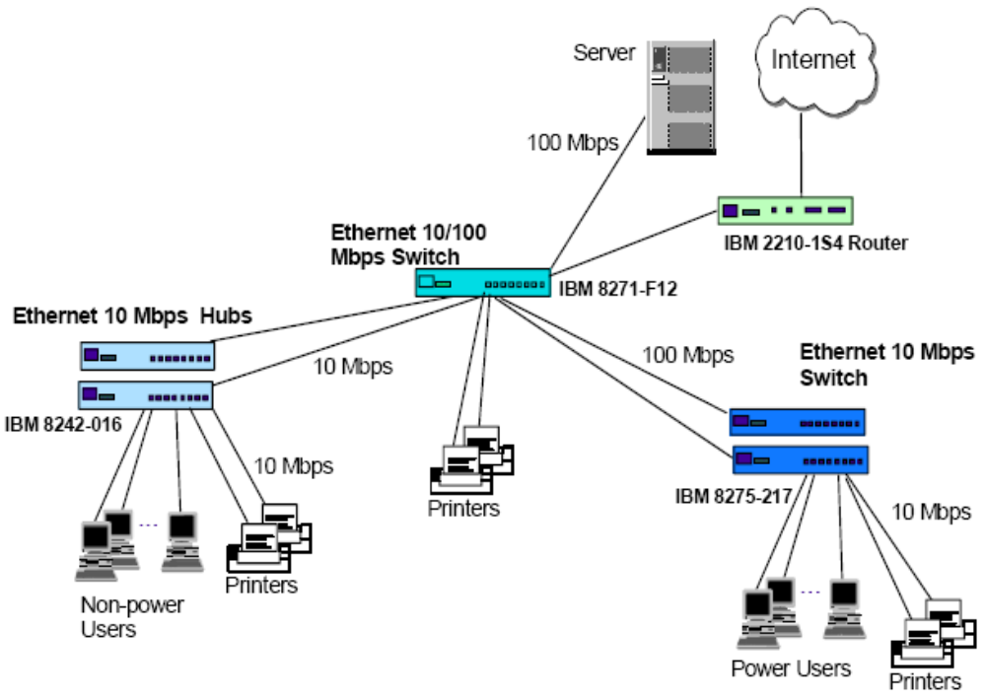
Physical diagram
Internet Engineering Course; Sharif University of Technology

Slide 135
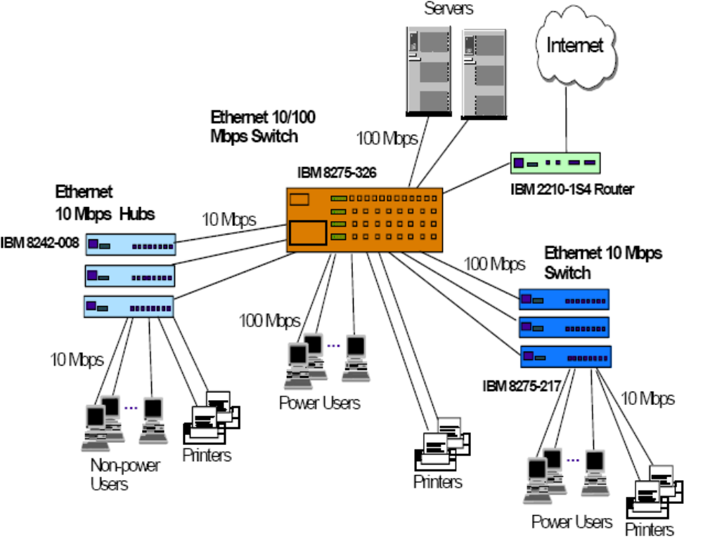
Physical diagram – expansion plan
Internet Engineering Course; Sharif University of Technology

Slide 136
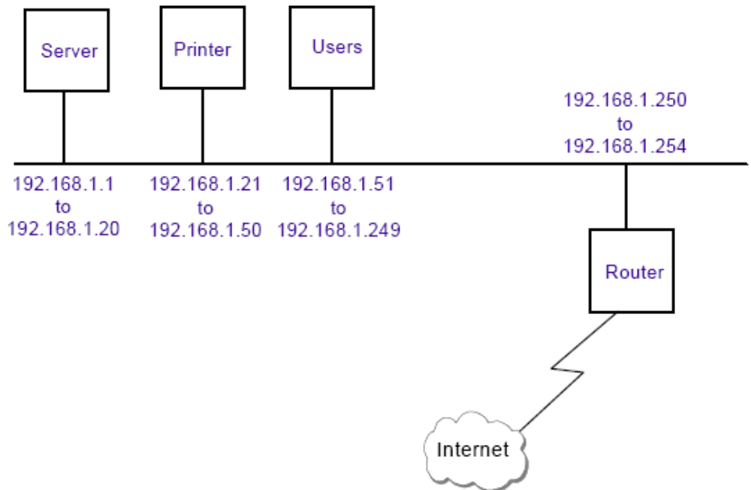
Logical network design
Internet Engineering Course; Sharif University of Technology

Slide 137
Network management
Because of tight budget it is hard to have a dedicated network management workstation
The simplest way is to select switch and hub devices that have web interface
Internet Engineering Course; Sharif University of Technology

Slide 138
Addressing and Naming
For this size of network a Class C address should be used.
A private Class C address is used: 192.168.1.0 to 192.168.1.255
Dynamic or Static IP assignment?
  It might be hard and maintain a DHCP server
  Therefore for small sized network we may decide to use static IPs.
How about a DNS server?
  Again setting and maintaining a DNS for this size of network may not be beneficial
  Therefore a simple naming scheme maybe used
Internet Engineering Course; Sharif University of Technology

Slide 139
Connecting the network to the Internet
In the design we used private IP addresses:
  Computers can’t use Internet directly, there is a need for NAT functionality
  There exists the advantage of security of network
It is decided to use a router with built-in NAT functionality
It is not cost effective to host email and Web service inside the organization
Therefore such servers are outsourced
Internet Engineering Course; Sharif University of Technology

Slide 140
Medium sized Network (<500 users)
Fixed annual budget for IT expenditure
MIS department taking care of the information system
Develop own in-house applications
Availability of one or a few dedicated network engineers
Invest in server/host fault tolerance features
May provide dial-in service to mobile workers
Internet Engineering Course; Sharif University of Technology

Slide 141
A sample firm
Connecting 300 users to a network
The company has a AS/400 host and 8 Windows NT file servers
There are 6 departments in the company, each with its own applications:
  Marketing – mainly email with external customers, calendaring, word processing, presentation applications
  Customer support – mainly handling customer queries, accessing the host for in-house developed applications
  MIS – development of applications on AS/400
  Human Resources – Mainly word processing
  Engineering – make use of CAD/CAM workstations
Internet Engineering Course; Sharif University of Technology

Slide 142
Connectivity design
Power users, such as the Engineering department, will have 100 Mbps switched connections to the desktop
Because Marketing users deal with graphics presentation, they will be connected to the 10 Mbps switch in a ratio of 16 users to a switch.
Since Customer Support and Human Resources users require fewer computing resources, they are connected to the 10 Mbps switch in a ratio of 24 to a switch.
Except for the server in the Engineering department, all the servers are
connected to the backbone switch at 100 Mbps. The engineering server is connected to the switch in the Engineering department at 100 Mbps.
Internet Engineering Course; Sharif University of Technology

Slide 143
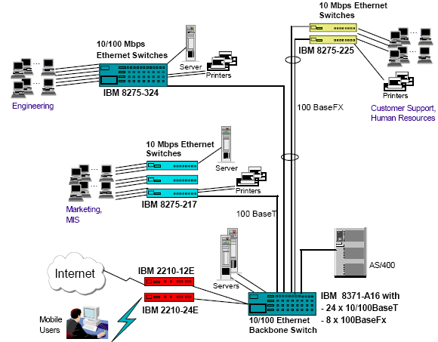
Physical diagram
Internet Engineering Course; Sharif University of Technology

Slide 144
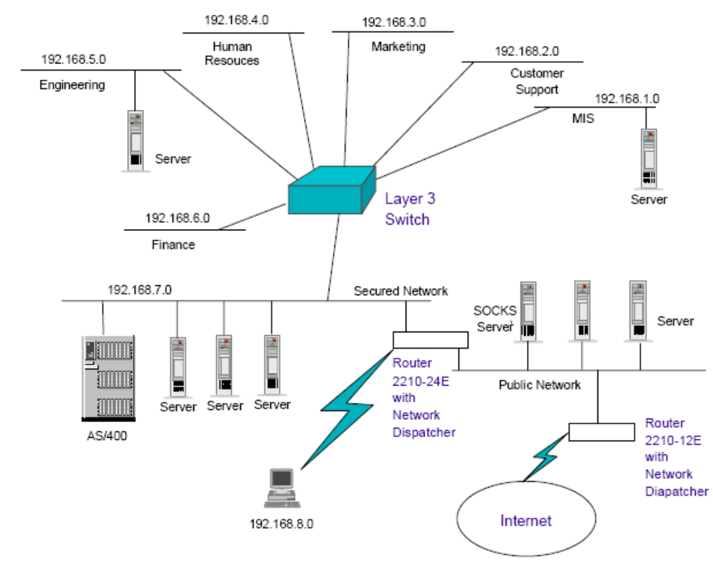
Logical network design
Internet Engineering Course; Sharif University of Technology

Slide 145
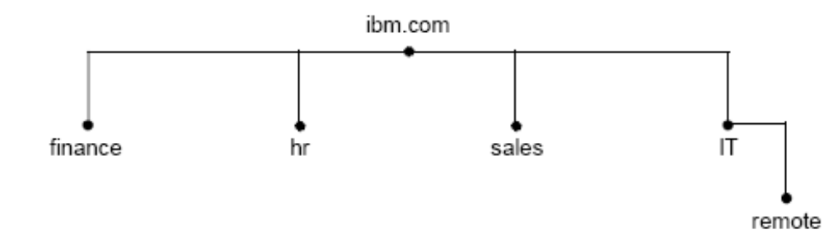
Logical network design (cont.)
With a network of this size it is beneficial to have a DHCP server
Also it is better to have a DNS for name resolution:
Internet Engineering Course; Sharif University of Technology

Slide 146
Remote access
15 dial-in users
8 maximum concurrent dial-in connections
A dial-back service will be implemented. That is, a remote user initiates a call to the router and triggers the router to dial back to the user.
Remote users have to authenticate themselves through a login ID and a password.
Internet Engineering Course; Sharif University of Technology

Slide 147
Addressing and Naming
There is a requirement for three public addresses to be obtained from the organization’s ISP. These would be for the organizational firewall, the services server hosting FTP, HTTP and e-mail services, the primary DNS server.
All these servers should have their IP addresses assigned statically.
Organizational domain name must be registered
To reduce WAN traffic, the primary DNS server may be placed on the ISP site.
Internet Engineering Course; Sharif University of Technology

Slide 148
Large size network (>500 users)
Internetwork of networks, with a mix of technologies such as Ethernet,
token-ring, FDDI and ATM.
Involves multiprotocol such as TCP/IP, IPX, SNA or NetBIOS.
Fault tolerance features for mission-critical applications, such as hardware redundancies, network path redundancies and extensive investment on backup services.
Fairly large MIS department to take care of the information system
In-house application development teams that constantly look at the deployment of new Internet technologies such as Java and multimedia applications.
Availability of experts in areas such as system management, network infrastructure and management.
Substantial amount of company’s annual budget is spent on IT investment.
Internet Engineering Course; Sharif University of Technology

Slide 149
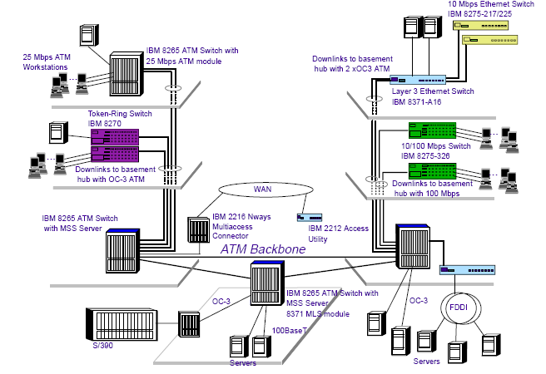
Physical diagram
Internet Engineering Course; Sharif University of Technology

Slide 150
CE site physical design
Internet Engineering Course; Sharif University of Technology

Slide 151
Reference
IP Network Design Guide, Martin W. Murhammer, Kok-Keong Lee, Payam Motallebi, Paolo Borghi, Karl Wozabal
Internet Engineering Course; Sharif University of Technology

